Slide 1
5. RING Capacity
ADVANCED
OPERATIONS
TRAINING
© Copyright Scality 2022
RING 8.5

Slide 2
RING Capacity
At the end of this module, you will be able to …
… understand how deleted objects impact RING capacity
… and also know when to plan for a capacity extension.
Notes:
Last update: 20180410

Slide 3
Contents
Object Lifecycle
Split Objects & Garbage Collector
The Purge task
Understanding Capacity Overhead
Capacity Planning

Slide 4
Object Lifecycle
PUT
NEW
DELETE
DELETE
PURGE
(PURGED)
RELOCATION
(REMOVED)
Referenced in node memory
Init. version: 64
Stored on disk
Still referenced in node memory:
Flagged DELETED
Version +64
Still stored on disk
Bizstorenode task
De-referenced from node memory
Still stored on disk
Biziod task
Removal from disk:
Algorithm-based
Container-based

Slide 5
Split Objects
S3, Sproxyd and RS2 Connectors.
Only on the Data RING.
Flag: SPLIT
K1
K2
K3
K4
Connector
On PUTs, the connector:
splits large objects into smaller chunks:
S3 and Sproxyd: 64+ MB objects are split into 32 MB chunks.
RS2: 4+ MB objects are split into 2 MB chunks.
Data RING
PUT
K1
PUT
K2
K3
K4
and creates an index object also stored in the data RING.
F: SPLIT
ID: 0x44
F: SPLIT, DELETE
On DELETEs, the connector:
Connector
K1
K2
K3
K4
K1
K2
K3
K4
Data RING
COPY
flags the index object as DELETE,
DELETE
DELETE
creates a special Garbage Collector object,
K1
K4
and nothing else.
K2
K3
Note: The File-based (SOFS) connectors have a different process to deal with large files, but still involving splitting (creating stripes) and an index.
Notes:
F = Flags
A SPLIT index can be created in other circumstances:
As a way to rollback on a partially-written split object due to a write error
As a way to track then remove old versions of the data for split objects that have been rewritten

Slide 6
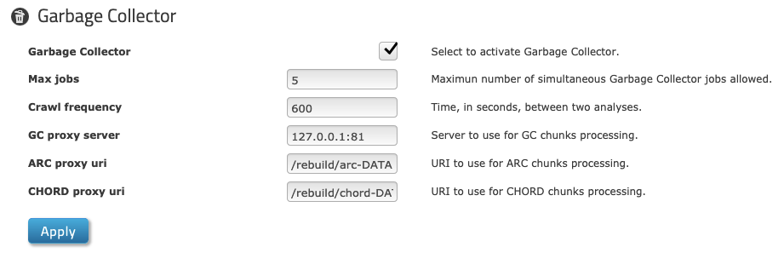
Garbage Collector
The Garbage Collector actually sends DELETEs to chunks from Split Objects.
It is a bizstorenode scheduled task, running by default every 600 seconds.
F: DELETE
ID: 0x44
F: DELETE
K1
K2
K3
K4
Data RING
GARBAGE COLLECTOR
K1
At that time, the bizstorenode:
F: DELETE
parses the special Garbage Collector object,
K2
K4
for all the keys listed in the GC object, issues individual DELETE operations,
F: DELETE
K3
all the Split Object chunks and the GC object are flagged DELETE.
F: DELETE

Slide 7
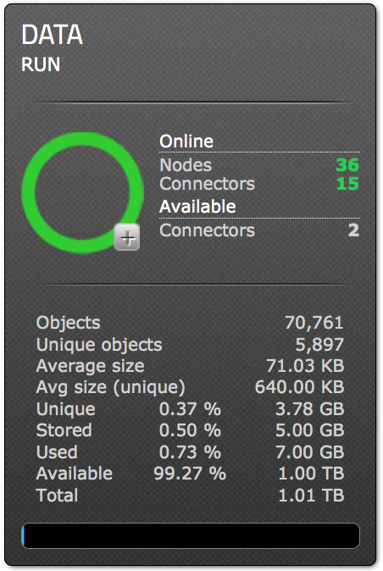
Data Removal Process
Node
Disk (biziod)
User/App
Connector
flag:DELETE
version
mtime
+ delete queue
DEL(file.txt)
DEL(Key)
Data is still on the disk
204 OK (async)
200 OK
GET(file.txt)
CHECK(Key)
404 NOT FOUND
STATUS_DELETED
t > Retention ?
Purge
Removes record from memory,
Removes record from bizobj.bin,
Create a trace in a .log file.
Data is still on the disk
⬅ Objects count decreases.
⬅ Stored (total size) decreases.
⬅ Unique objects count decreases.
⬅ Unique (total size) decreases.
Reads the .log files,
Elect containers with reclaimable slots,
Frees up disk space.
Relocation
⬅ Used size decreases.
Notes:
Purge runs by default every minute, the retention is a week.
Relocation runs at least once a day for each disk.

Slide 8
Relocation: Containers
Containers are files where objects data are concatenated on the disks:
128 MB (default max size) files stored with extension .dat.
Biziod (IO daemons) store containers on the data disk in data directories:
They provide an efficient way to store data, avoid file system contentions and inodes exhaustion.
A container name is totally random and has nothing to do with the RING keys.

Slide 9
Relocation Task
Containers are eligible for relocation based on the purged data they contain and the available capacity on the disk.
Old Container
Purged
Purged
Used
Used
Purged
Purged
Used
Purged
Purged
Purged
Used
Used
Used
Free disk space reclaimed
New Container!
Once all used objects has been moved, the old container is deleted.
Notes:
The relocation browses the bizobj.bin looking for the records of the “Used” objects to move away from the container before its deletion → performance implication
The 128MB of the new container are reserved contiguously on the disk to avoid fragmentation

Slide 10
Understanding RING Usage (1)
Net vs Stored vs Raw
Let’s take a Data RING, using exclusively ARC9+3.
Total
Case 1: the application writes a 1 GB file:
Net used ⬆ by 1 GB
Raw stored ⬆ by 1.33 GB
Raw used ⬆ by 1.33 GB
~ 25 % of raw total
Total
Case 2: the application deletes a 1 GB file:
Net used ⬇ by 1 GB
Raw stored is not impacted
Raw used is not impacted
Used
Used
Stored
Stored
Case 3: after Case 2, eventually a Purge task is executed:
Net used is not impacted
Raw stored ⬇ by 1.33 GB
Raw used is not impacted
Used
Used
Case 4: after Case 3, eventually Relocation gets to the data:
Net used is not impacted
Raw stored is not impacted
Raw used ⬇ by a undefined amount (algorithm-based).
(*) Net = Unique in the RING Administration Interface
Raw
capacity
Net* capacity
Notes:
25 % = 100 - Ratio(ARC9+3) %

Slide 11
Understanding RING Usage (1)
Net vs Stored vs Raw
Let’s take a Data RING using exclusively ARC9+3
, and for instance a 1 GB file.
WRITE:
Net used ⬆ by 1 GB
Raw stored ⬆ by 1.33 GB
Raw used ⬆ by 1.33 GB
DELETE:
Net used ⬇ by 1 GB
Raw stored not impacted
Raw used not impacted
PURGE:
Net used not impacted
Raw stored ⬇ by 1.33 GB
Raw used not impacted
RELOCATION:
Net used not impacted
Raw stored not impacted
Raw used ⬇ by a undefined amount (algorithm-based).
Net Capacity ≃ 75% of Total Capacity
Net Used*
Total Capacity
Used
Stored**
Notes:
75 % = Ratio(ARC9+3) %
(*) Net Used is called Unique on the RING Administration Interface
(**) Stored only appears on the RING Administration Interface

Slide 12
Understanding RING Usage (2)
What’s in Stored and what’s in Used
Protection ratio * Net used +
deleted, non purged objects
= Stored
Stored +
purged, non relocated objects +
local files on disks (e.g. backups of bizobj.bin files)
= Used
What applications see
local files on disks
purged non relocated
Stored
deleted non purged
net used * ratio
🗒 (%large_objects)*(k+m)/k
+
(%small_objects)*n_replicas
= protection_ratio
Used
Raw used
Raw stored
Net capacity
Raw
capacity

Slide 13
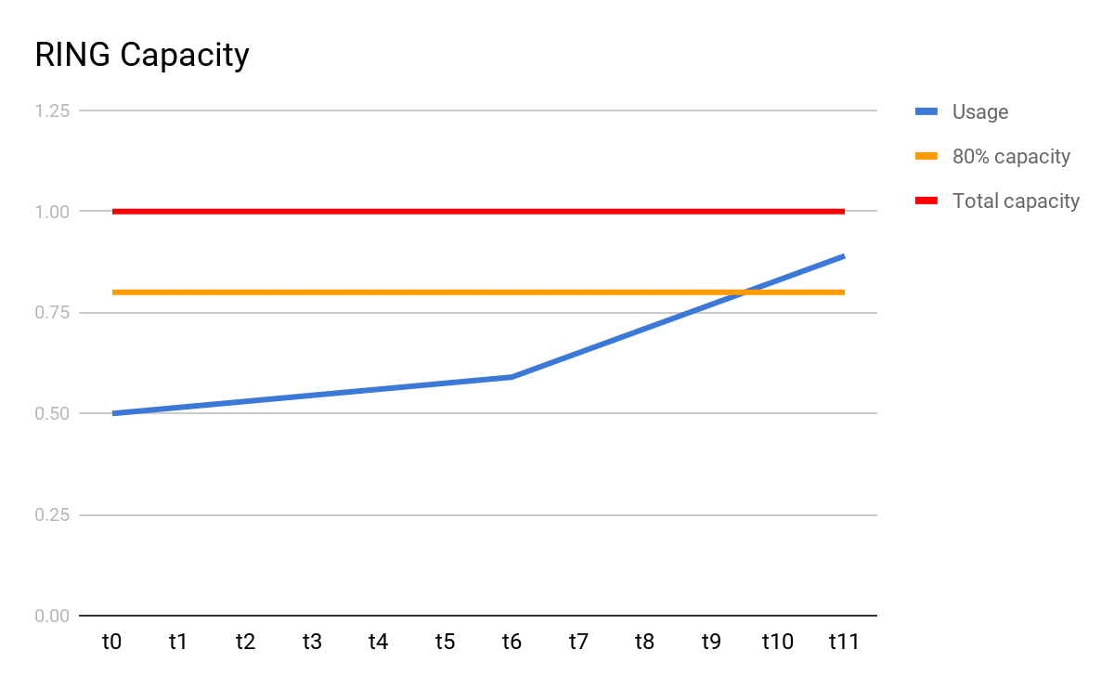
What Happens when Purge is Stopped ?
E.g. when a storage server fails, as per Split Detection
No Purge ⇒ no relocation ⇒ no data deleted from the disks ⇒ usage grows faster.
Worse case scenario, the disk usage warning threshold is reached during that downtime:
Create a P2 ticket at Scality Support.
If usage was already close to 80%: contact your Scality Account Manager to start planning for a Capacity Extension.
⚠
Storage server failure

Slide 14
Capacity Planning Variables
Used_{warning} (TB) = Capacity usage that should trigger a capacity extension plan.
Used_{critical} (TB) = Capacity usage you do not want to reach.
Growth (TB/day) = Projected rate at which the storage will be used.
Time_{order} (days)= Time between notification from operation team and hardware order.
➥ influenced by internal processes.
Time_{delivery} (days) = Time between order and hardware delivery.
➥ influenced by HW provider scheduling.
Time_{installation} (days) = Time between HW delivery and insertion into the RING.
Used_{warning} = Used_{critical} – Growth x (Time_{order} + Time_{delivery} + Time^{installation})

Slide 15
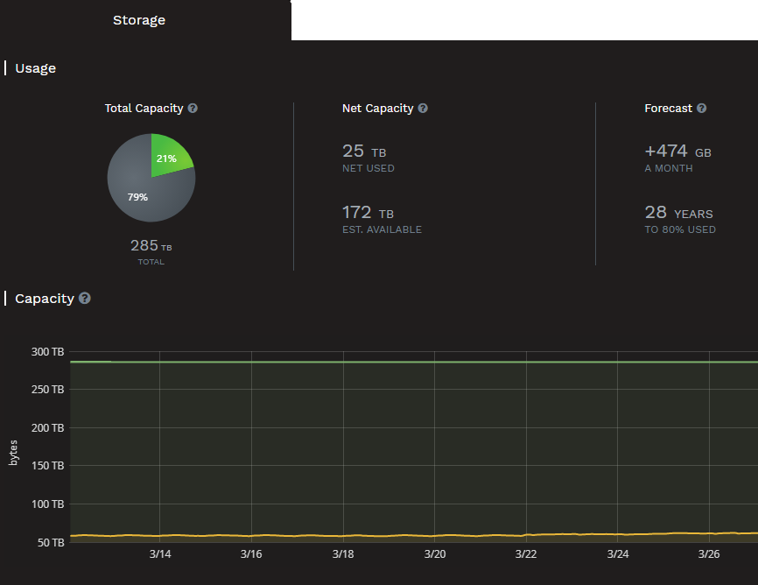
RING Capacity Forecast
With the Supervisor GUI
Forecasts present predictions based on existing data.
A MONTH growth metric represents the estimated RING usage variation over a month (e.g., +30 TB/month).
TO 80% USED represents the number of remaining days, based on the actual rate of data growth, before the 80%-full capacity threshold is reached.
If < 100 days, the RING global status changes to WARNING, LOW STORAGE.
If < 60 days, the RING global status changes to CRITICAL, LOW STORAGE. Contacting Scality Customer Support is strongly advised.
N/A is displayed when there is not enough data to compute this metric.
⇒ To reconfigure days thresholds, contact Scality Customer Support.
Notes:
Also available on the CLI

Slide 16
RING Monitoring
RING Status
Identify failed servers and/or disks
Capacity warnings
RING Utilization
Tracking time to 80% used
RING Latency
Identify networking issues
Identify failing/faulty hardware

Slide 17

QUESTIONS ?

